Slide 1
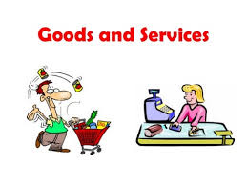
Exchanging resources
Every person in the community has needs and wants which must be satisfied by purchasing goods and services.

